Slide 1

Infrared Communication
Short-range, line-of-sight wireless technology enabling seamless device interaction
Presented by
Presented to
Md. Siam SarkerID: IT21057
Dr. Nazrul IslamAssociate ProfessorDepartment of ICT, MBSTU

Slide 2

Introduction to Infrared Communication
Infrared (IR) radiation operates in the electromagnetic spectrum between visible light and radio waves, with wavelengths ranging from 700 nanometers to 1 millimeter. This technology enables wireless data transmission over short distances through line-of-sight pathways.
Wavelength Range
Range
700 nm to 1 mm
Typically 1-10 meters
Line-of-sight
Requires direct path

Slide 3
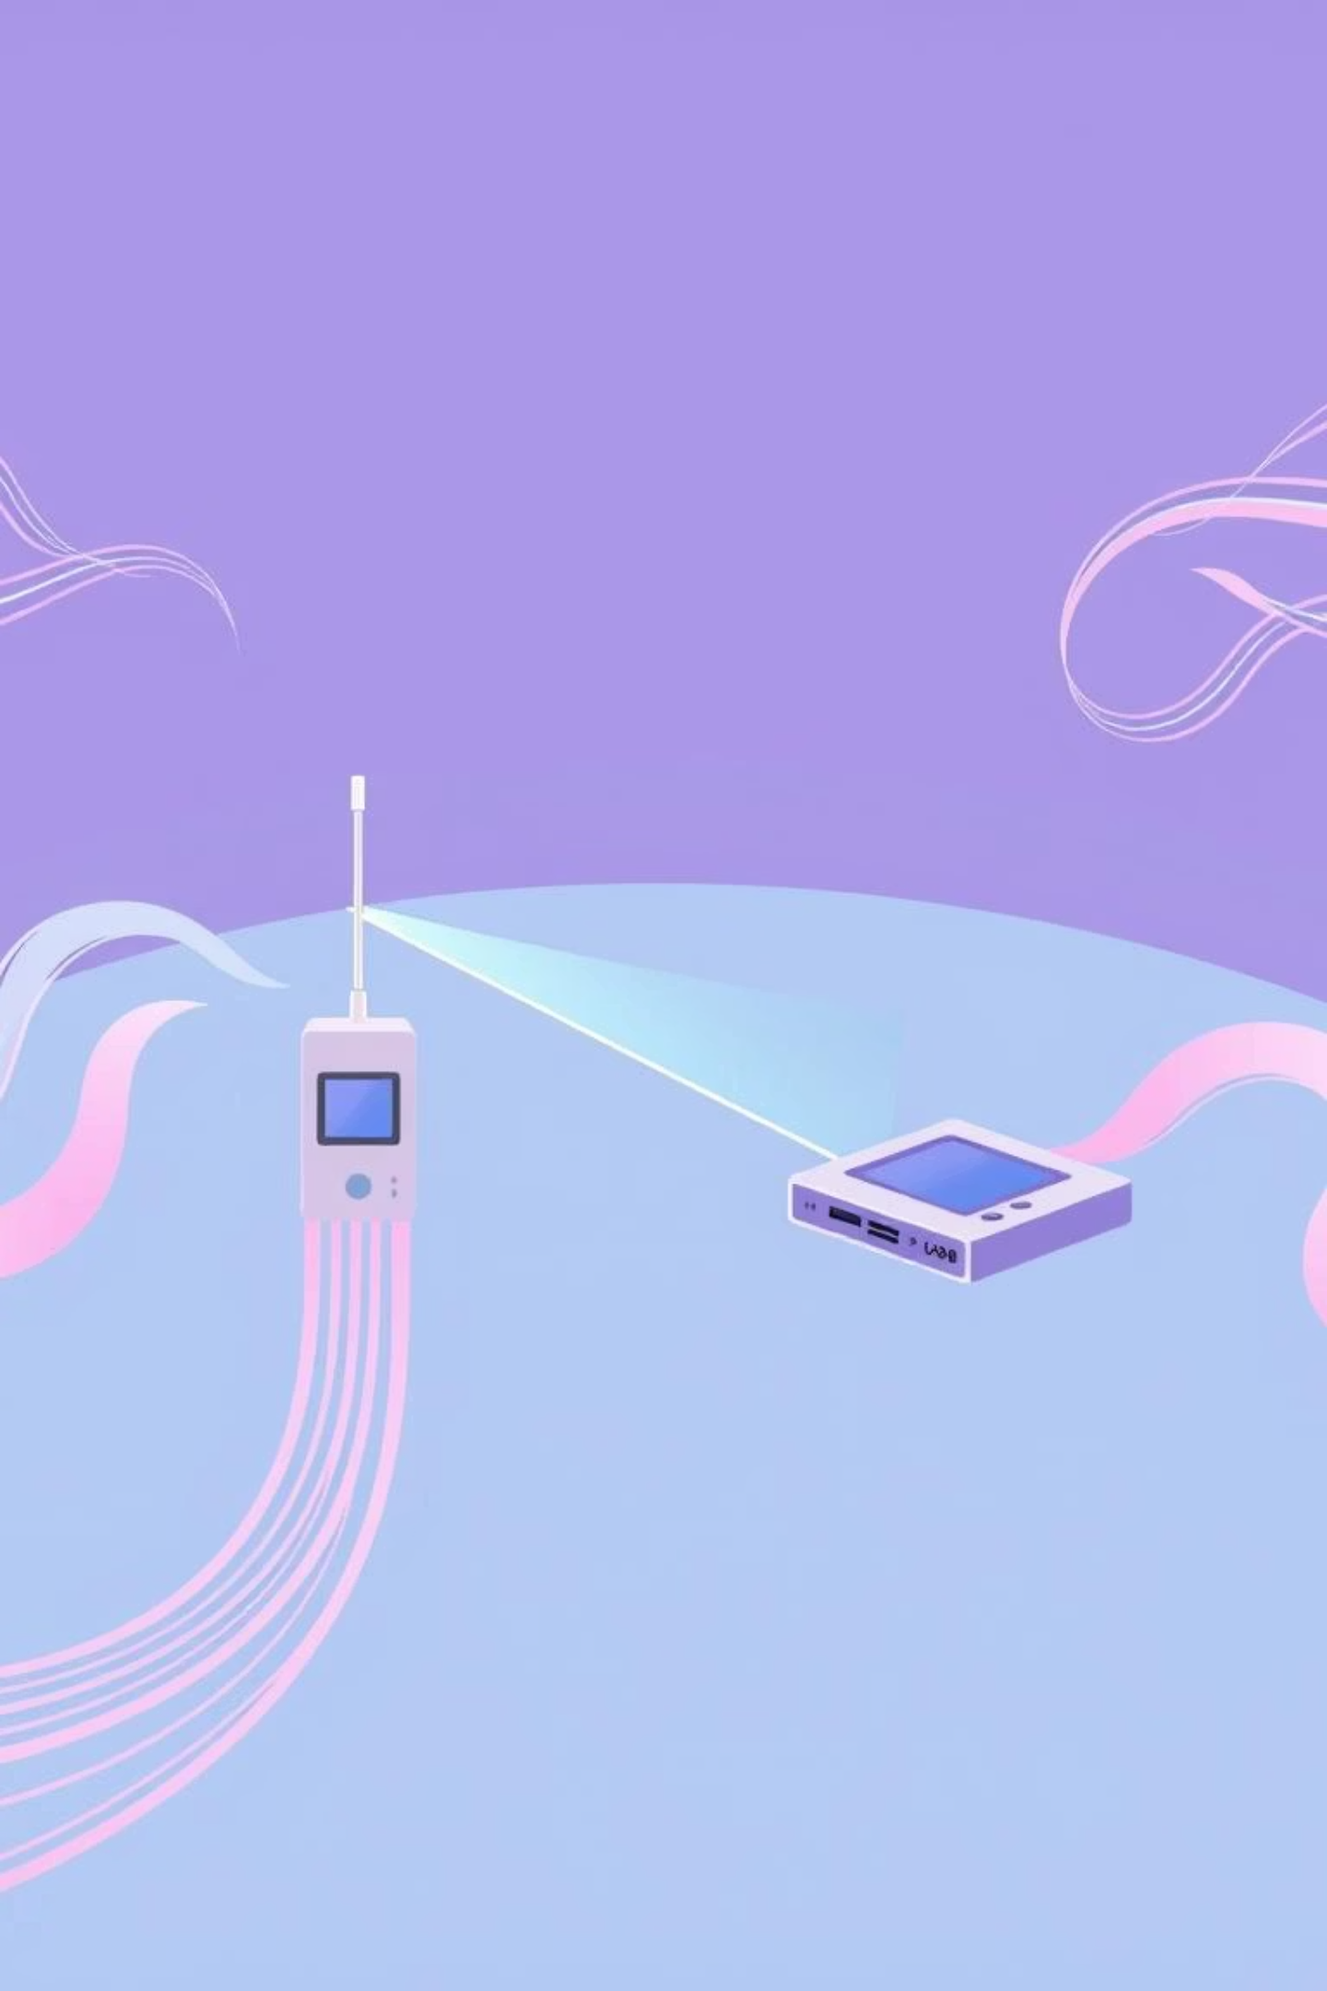




How Infrared Communication Works
Modulation
Data encoded onto IR signal
Transmission
IR LED emits modulated light
Reception
Photodiode detects signal
Demodulation
Data extracted and processed
IR communication uses light-emitting diodes (LEDs) to transmit data by modulating infrared radiation. Receivers with photodiodes detect these signals, converting light pulses back into electrical signals for data interpretation.

Slide 4
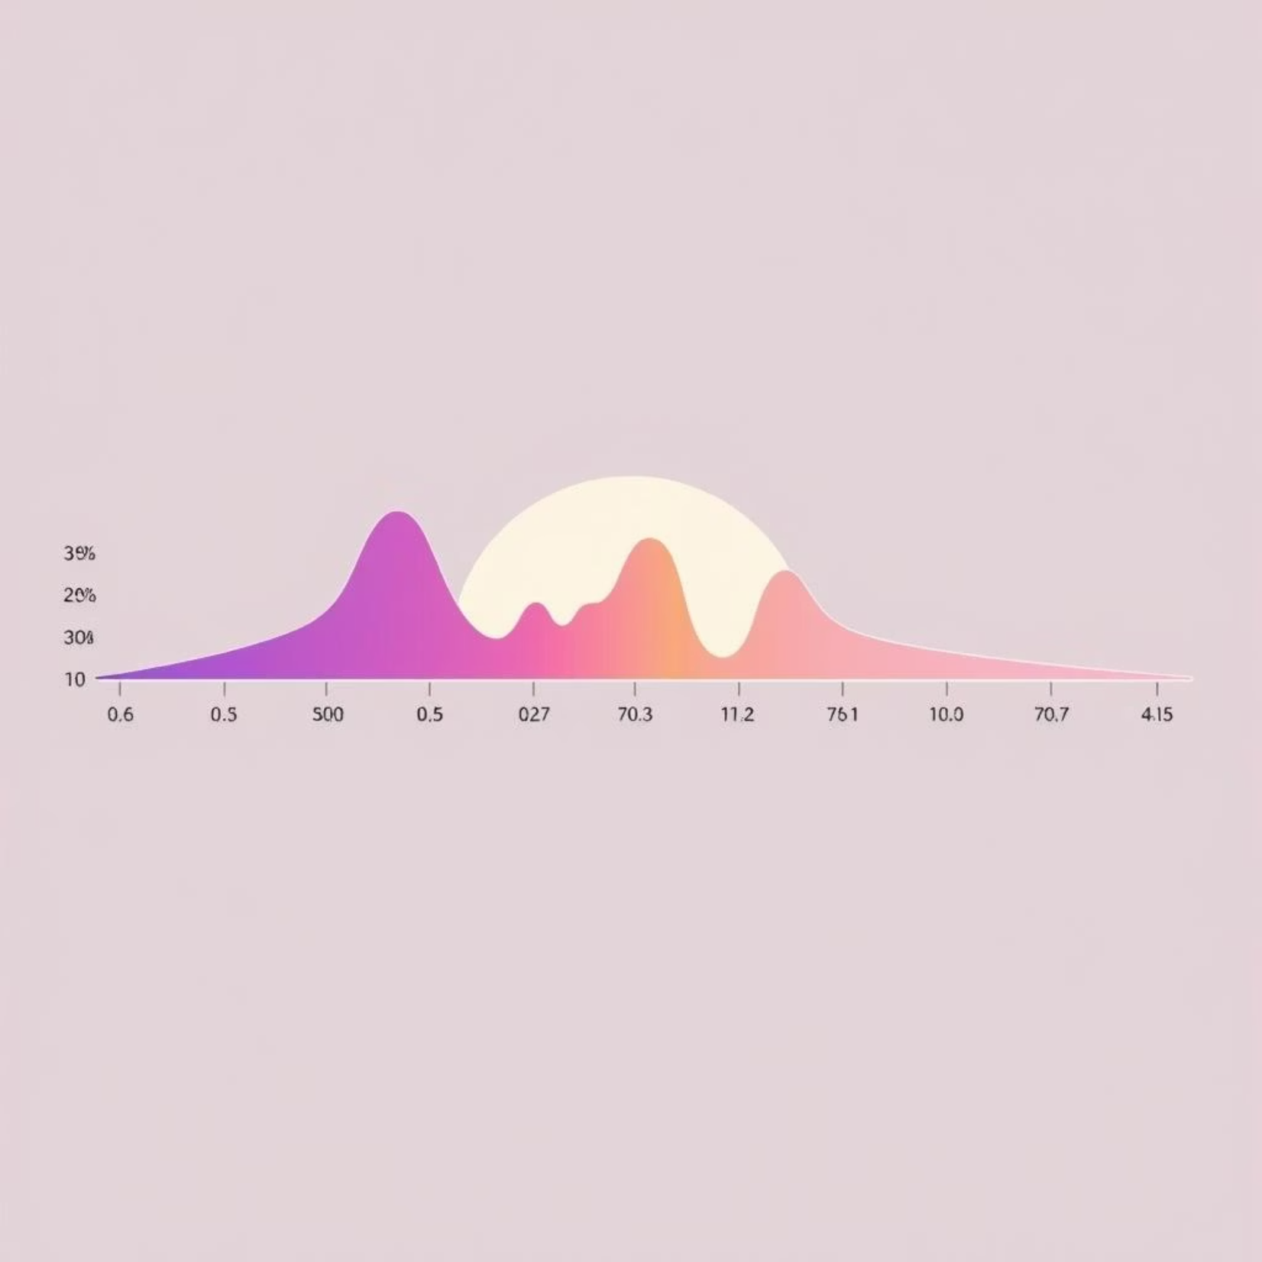
Infrared Spectrum and Wavelengths
Spectral Division
Near-IR (NIR): 0.7–3 µm
Mid-IR (MIR): 3–50 µm
Far-IR (FIR): 50 µm–1 mm
Communication systems typically operate in the near-infrared region (0.85–0.95 µm) for optimal performance and minimal atmospheric absorption.

Slide 5
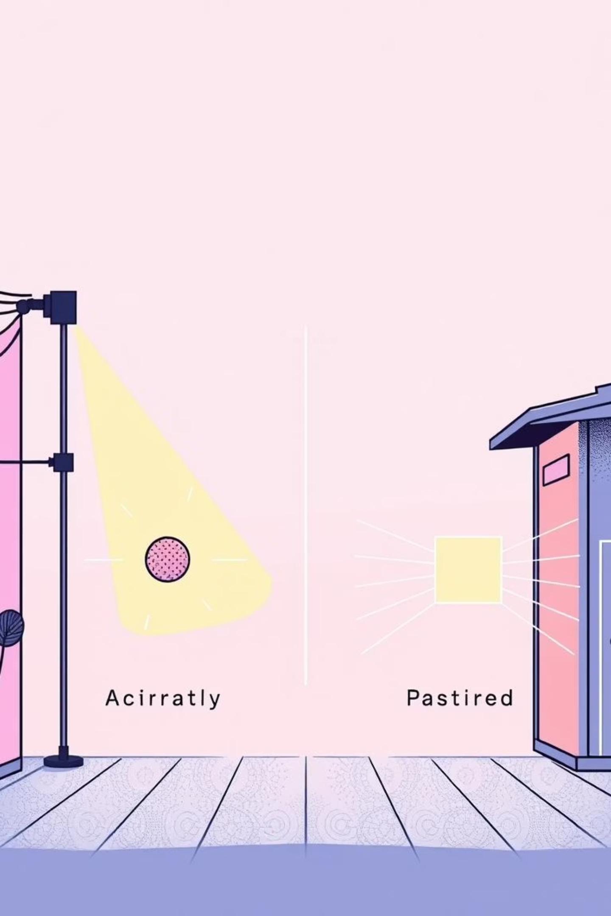
Types of Infrared Communication
Active IR
Transmitter emits IR signals; receiver detects reflections or direct signals
Passive IR
Receiver detects thermal radiation emitted by objects without transmission
Active systems dominate consumer applications like TV remotes and data transfer. Passive systems excel in thermal imaging and motion detection where no active transmission is needed.

Slide 6
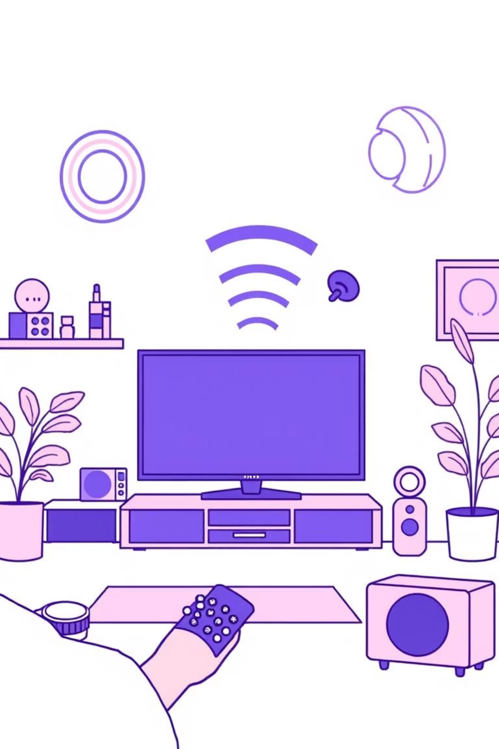

Common Applications
Remote Controls
Television, audio, and home automation devices
Proximity Sensors
Motion detection and object identification
Wireless Data Links
Short-range computer and mobile device communication
Thermal Imaging
Temperature monitoring and surveillance systems

Slide 7
Advantages of Infrared Communication
Safe and Non-ionizing
Cost-effective
Infrared radiation poses no health risks to humans, making it ideal for consumer electronics and frequent use environments.
Simple component design with inexpensive LEDs and photodiodes reduces manufacturing and implementation costs significantly.
Secure Communication
Low Power Consumption
Narrow beam angle provides inherent security by limiting signal propagation to specific line-of-sight paths only.
Efficient operation enables extended battery life in portable devices and remote controls.

Slide 8

Limitations and Challenges
Line-of-sight Requirement
Obstacles, walls, and barriers block infrared signals, limiting flexibility in complex environments.
Environmental Interference
Sunlight and other IR sources create noise, reducing communication reliability in outdoor settings.
Limited Range
Typical 10-meter maximum distance makes IR unsuitable for long-distance wireless applications.
Slower Data Rates
Lower bandwidth compared to RF and modern wireless technologies limits high-speed data transmission capabilities.

Slide 9

Future Trends and Developments
Visible Light Communication
VLC technology extends IR principles using visible LED light for data transmission with higher bandwidth potential.
Enhanced Modulation Techniques
Advanced encoding methods and digital signal processing improve data rates and noise immunity significantly.
IoT Integration
Infrared emerging as key enabler for Internet of Things applications in smart homes and industrial automation systems.
Space Communication
NASA and satellite programs exploring free-space optical communication using infrared for high-speed interplanetary links.

Slide 10

Conclusion
Infrared communication remains a foundational wireless technology, delivering reliable, secure, and cost-effective short-range data transmission. Despite line-of-sight limitations, IR continues evolving through visible light communication and advanced modulation techniques, positioning it as a key technology for next-generation IoT and smart device ecosystems.
Key Takeaways
Thank You
Safe, cost-effective wireless solution
Questions & DiscussionMd. Siam SarkerDepartment of ICT, MBSTU
Proven in consumer electronics
Evolving with emerging technologies

